Slide 1
DSIF5 Project 2 - Ames Housing
Team 2
Loh Wei Hao
Marc Tan
Ethan Lee
16 July 2022

Slide 2

Problem Statement
We are WEM general insurance based in Ames, Iowa specializing in home insurance.
Customers come to us looking to get their homes insured. A part of getting their homes insured requires the valuation of their property.
We have noticed through feedback forms that customers find our application forms:
Tedious and overly complicated
Usually take more than an hour for customers to fill up (total of 80 questions)
Customers do not want to spend more than 10 mins
Due to the high dropout rates, management is concerned with the loss of revenue and share of customers to our competitors, who offer quicker and more accurate processing times.

Slide 3
Our immediate task
As a group of data scientists within the firm, we have been tasked to simplify the application process through automating this process using machine learning models.
These predictive valuation models will help to:
Effectively predict the valuation of the property
Improve efficiencies and the overall customer end-to-end experience
Increasing take-up rate due to quicker turnaround times through quicker processing times
Current process takes one week end-to-end
Customer writes information on form
Passes form to front desk for filling in system
Company clarifies on missing fields or data inaccuracy
Valuation of property for purpose of underwriting
Revised process takes only ten minutes!
Customer keys information into form directly
Model generates valuation ready for underwriting

Slide 4
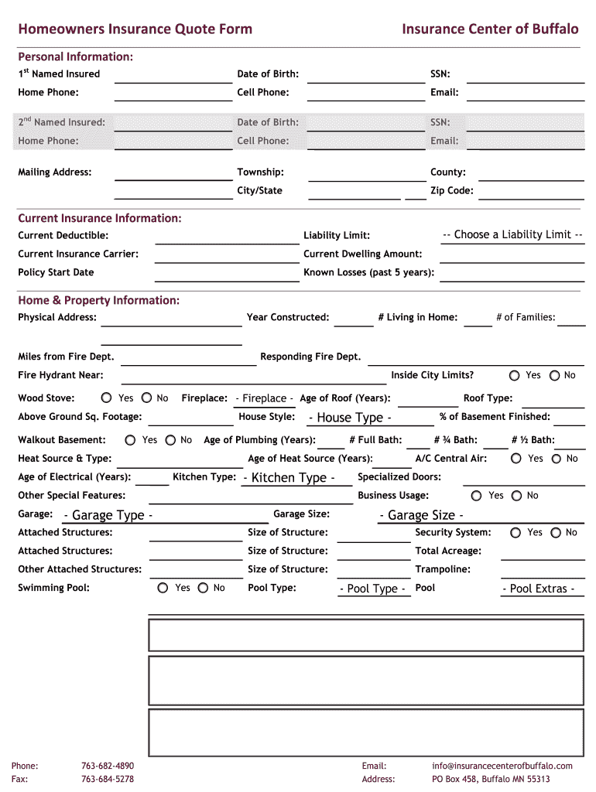
Our current application form
WEM Insurance
This is a sample of our form (Page 1 out of 5).
Customers tend to only complete one page and drop out.
Given that the form is manual, customers who make it to the end:
Usually fill up the forms incorrectly (funny values)
Leave plenty of blanks (null values)
In turn, data inaccuracy and missing fields will require follow-ups (in turn increasing the whole on-boarding process)
When the front desk staff transfers this information to the database:
Keys in the wrong values (human errors)
Leave plenty of blanks (null values)
Page 1 of 5

Slide 5
How we intend to improve the process
Eliminate manual forms (to save staff costs and time taken)
Introducing online forms (to save paper and less answer errors)
Greatly reduce the number of questions in form through data science!
Customers must be able to complete under 10 mins
We aim for less than 20 questions
Combine similar or repeated questions
No open ended questions
Customers would only be required to tick checkboxes, answer yes/no/others, or indicate based on a number scale (data validation checks front-end)
Revised process takes only ten minutes!
Customer keys information into form directly
Model generates prediction
Notes:
INTENDED AUDIENCE -> SENIOR MANAGEMENT

Slide 6
Database of historical sale prices
Management has given us access to a historical database of 2051 homes in the Ames area.
Dataset shows 80 sets of features as captured from the original application form.
Dataset also shows the sale price of each home when it was sold. We will use this as the valuation of the homes.
X = 80 features
from the questions…
… from 2051 of
these forms!
Y = Sale prices of homes

Slide 7
Exploring the dataset
In order to drastically reduce the number of features, we need to find:
Strong predictors (to keep)
Skewed values (to drop)
Null values (to fill up)
Repeated/ similar questions that can be combined (to reduce features)
Change as many categorical questions into binary/ ordinal questions
Outliers (to drop)

Slide 8
Strong predictors against the sale price
9 Features | Correlation against sale price
Overall quality | 0.800
Gross living area | 0.697
Garage area | 0.650
Cars that can fit in garage | 0.648
Total basement area (sqft) | 0.629
1st floor area (sqft) | 0.618
Year house was built | 0.572
Year remodelled | 0.550
No of full baths | 0.538
Some of the important predictors include the quality, area and age features.
We will keep and use these predictors as questions in our application form.

Slide 9
Skewed features
Features | Highest % of a single value | Interpretation
Alley | 93.17 | 93% of homes do not have an alley
Utilities | 99.90 | 99% of homes have electricity, gas, water and sewage
Land slope | 95.22 | 95% of homes are built on a gentle slope
Roof material | 98.73 | 99% of homes have roof made of composite shingles
Some features have a very high % of a single value. Such features are usually poor predictors and can be dropped.
For e.g. Asking a customer if his house has utilities in this day and age is seemingly redundant.
Recommendation: Drop most of the skewed features

Slide 10
Null values
We expected null values in the dataset for the following reasons:
Clerical mistakes
Incomplete form
No suitable values
Recommendation:
Fill up categorical questions with “NA”. Convert any possible categorical features into numerical ones.
Fill up numerical questions with zeros
Prevention Measure
The new form will have data validation and restrict free text.
Type of feature
Categorical
Numerical
Fill with “NA” and map to numerical
For e.g. Basement quality change to scale of 0-5 where 0 indicates no basement
Fill with “NA”
For e.g. Garage type can be Attached, Detached, Built-In, Basement, or NA (no garage)
Fill with Zeros
For e.g. Fill basement area with zeros for those homes without a basement

Slide 11
Combining redundant questions
Feature 1 | Feature 2 | Correlation | Interpretation
Year garage was built | Year house was built | 0.83 | Garage & House built together
Garage area | Cars in garage | 0.89 | Bigger the garage, the more cars it can fit
First floor area | Basement area | 0.81 | Basement area likely to increase in tandem with first floor area
Multicollinearity: This is when an independent variable is highly correlated with another independent variable. We have to get rid of it to have more reliable inferences.
Recommendation: Keep only one independent term and drop other highly correlated terms

Slide 12
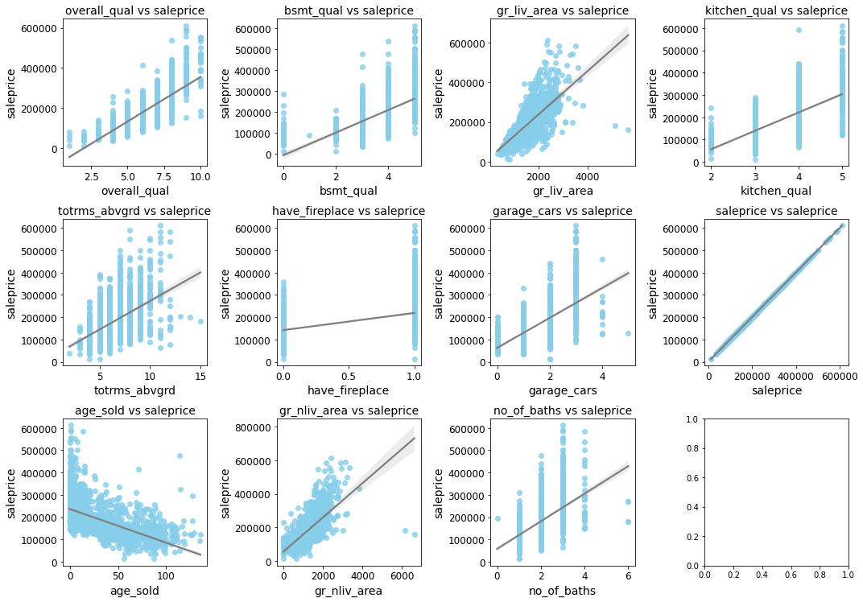
Outliers
Contributes to large errors during regression analysis
Use a scatter plot to quickly identify and remove outliers
Recommendation: Drop to get a better line fit for each independent variable

Slide 13
After preprocessing
Categorical features
Numerical features (with correlation to sale price)
We are left with 7 categorical features and 10 numerical features.
Numerical features show a high correlation to the sale price, which should give us a good model prediction.
Neighbourhood
MS Subclass
MS Zoning
House style
Exterior
Masonry veneer type
Foundation
Gross living area (0.72)
Gross non-living area (0.70)
Cars in garage (0.66)
Year built (-0.57)
No of baths (0.60)
Fireplaces (0.49)
Total rooms (0.51)
Overall Quality (0.80)
Basement Quality (0.61)
Kitchen Quality (0.70)

Slide 14
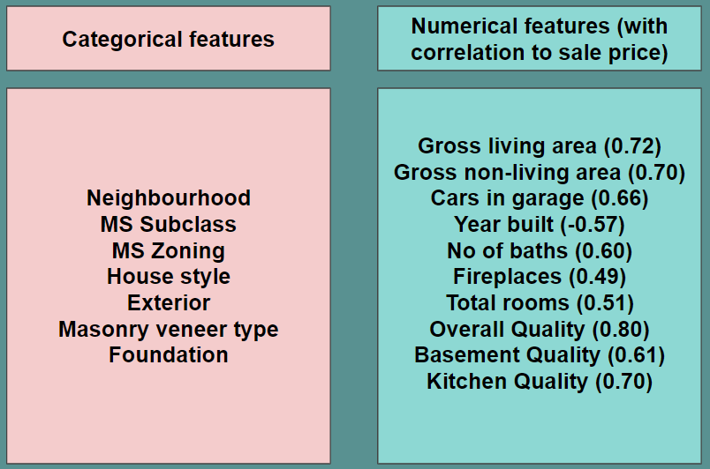
Black box to test our models
We throw our features into 4 different black boxes to generate a predicted sales price.
Each black box contains different parameters to optimise the model score.
We want to find the black box that gives us the least test error with good generalization.
Black box 1
Predictions 1
vs
Y = Sale prices of homes
Which black box gives the least test error, with good generalization?
Black box 2
Predictions 2
vs
Black box 3
Predictions 3
vs
Split 70% to fit black box,
30% to test black box
Black box 4
Predictions 4
vs

Slide 15
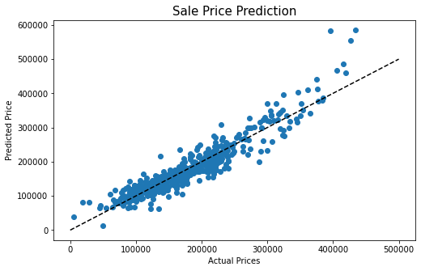
Results
Black box 2 performed the best with a 1.97% difference between the train and test set (good generalization) and also has the small test error (low variance)
Predicted and actual values fit nicely on a linear graph
However model does not perform well when predicting above $390k
We can improve on model by offsetting all predicted values that are $500k and above (so that it moves closer to the dotted line)
Model | Error (train) | Error (test) | Difference (%)
Black box 1 | 26687 | 27256 | -2.13%
Black box 2 | 26696 | 27222 | -1.97%
Black box 3 | 26690 | 27236 | -2.05%
Black box 4 | 29482 | 29577 | -0.32%

Slide 16
Final application form
Please choose your neighbourhood, MS Subclass and MS Zoning (these are found in your house document sheet)
Please fill in your house style (1 story or 2 story or Others)
How big is your living area? (add first floor and 2nd floor sqft)
How big is your non-living area? (basement area and porch area sqft)
How many rooms are there?
How many full baths are there?
Do you have a fireplace?
How many cars can your garage fit?
When was your house built? (enter year)
When was the application form filled up (Can be calculated back end = Mths Sold)
What is the exterior finishing on your house
What is your masonry veneer type? (Brick, stone, others or none)
What kind of foundation is your house on? (Cinderblock, Concrete, Bricktile or others)
What is the overall material and finish quality of your house (1 to 10)
What is the height of your basement? (convert 1 to 5)
What is your kitchen quality? (1 to 5)
Please click here to fill up the form.

Slide 17
Conclusion
We were able to get a sufficiently good model that is relevant for our use case:
Shortens drastically the time a customer takes to fill the form
Decreases the dropout rate and increase revenue
Simple and easy to understand application form
Scalable savings
We can improve the process further by:
Create and deploy a simple web application for customers to get instant results instead of through email
For higher valued homes:
Model may not perform as well when prices exceed roughly USD 390,000 and up
It would be advisable that an on-site valuation be handled by human intervention
Alternatively, gathering of data for the higher valued homes will also help in assisting the model to better predict home prices in excess of USD 390,000
Get house pricing data from other years instead of during the Financial Crisis

Slide 18
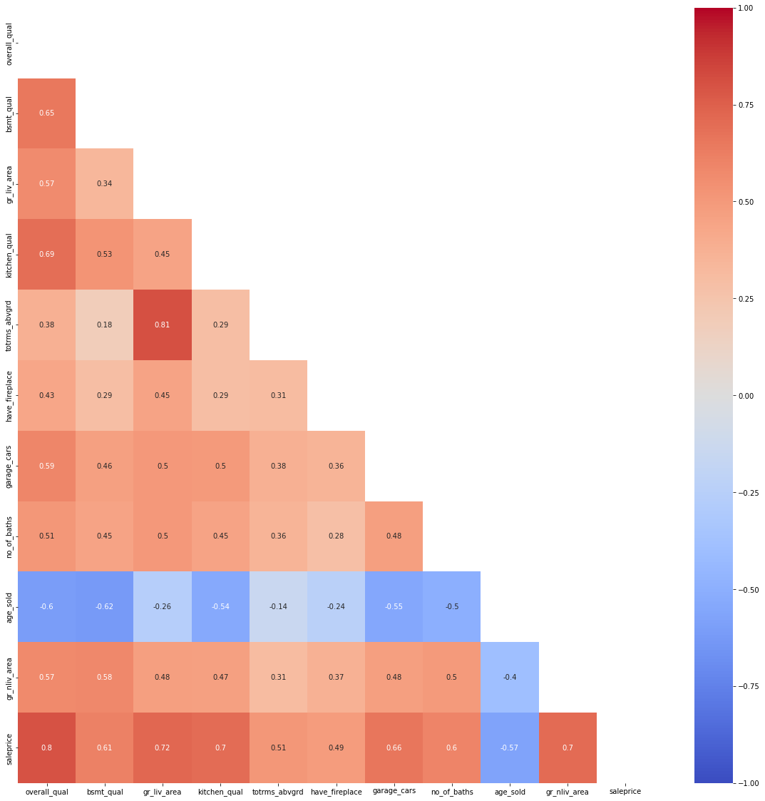
APPENDIX
Size
Gross living area (gr_liv_area)
Gross non-living area (bsmt area + porch area = gr_nliv_area)
GarageCars: Size of garage in car capacity
Profile
Neighbourhood
MS subclass
MS zoning
House style (1 or 2 story or others)
Time factors
Year built
Features
No. of baths
Fireplaces: Number of fireplaces
Total rooms above grade
Finishing
Exterior1st: Exterior covering on house
Masonry veneer type (Brick, stone, others or none)
Foundation (Cinderblock, Concrete, Bricktile or others)
Quality
OverallQual: Overall material and finish quality
BsmtQual: Height of the basement
KitchenQual: Kitchen quality

